Slide 1
The Conceptual framework
Year 11

Slide 2
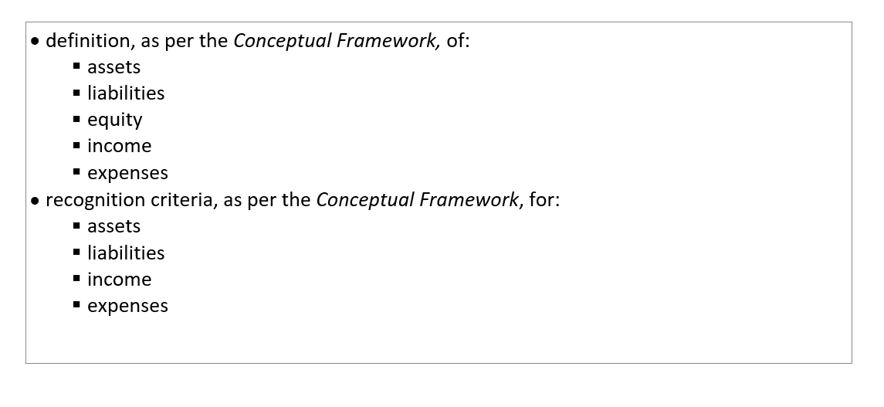
Relevant syllabus dot points Year 11

Slide 3
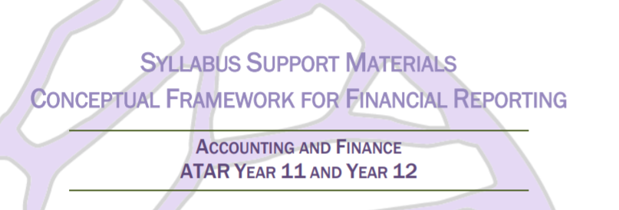
SCSA support material continued
h Years 11 and 12 | Accounting and Finance (scsa.wa.edu.au)

Slide 4
Year 11….

Slide 5
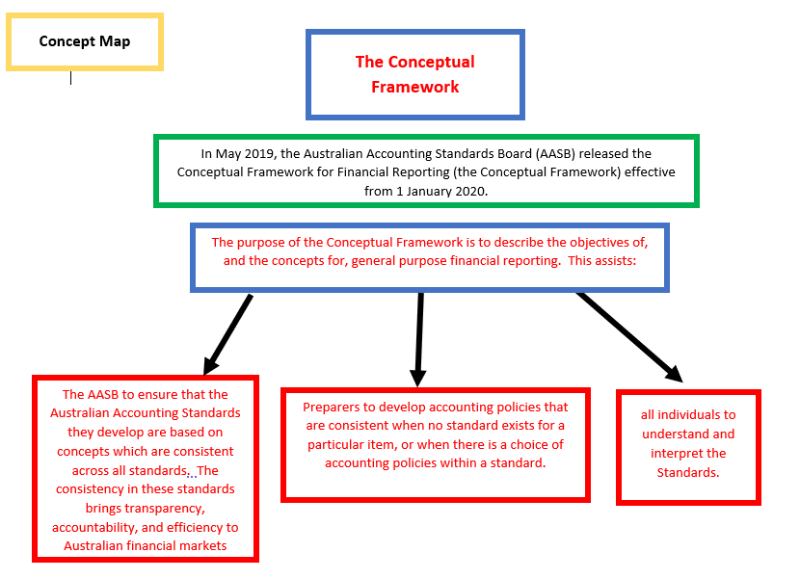

Slide 6
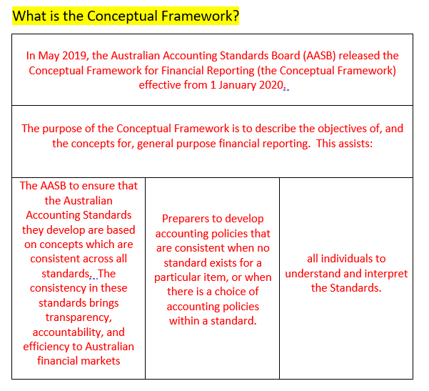


Slide 7
In Year 11 Accounting and Finance, students are required to understand the definitions and recognition criteria for: assets, liabilities, equity, income and expenses. This is one part of the Conceptual Framework.
We are covering the definition and recognition of assets, liabilities, equity, income and expenses as per the Conceptual Framework. These definitions are more complex than the simpler definitions used earlier in the Year 11 course.
The Conceptual Framework can be accessed via the following link: https://www.aasb.gov.au/admin/file/content105/c9/Conceptual_Framework_05-19.pdf.

Slide 8
Definition v recognition
The Conceptual Framework states that “Only items that meet the definition of an asset, a liability or equity are recognized in the statement of financial position. Similarly, only items that meet the definition of income and expenses are recognized in the statement of financial performance. However, not all items that meet the definition of one of those elements are recognized.
Therefore, it is possible for an item to meet the definition of an element but not meet recognition criteria – this should also be explored.

Slide 9
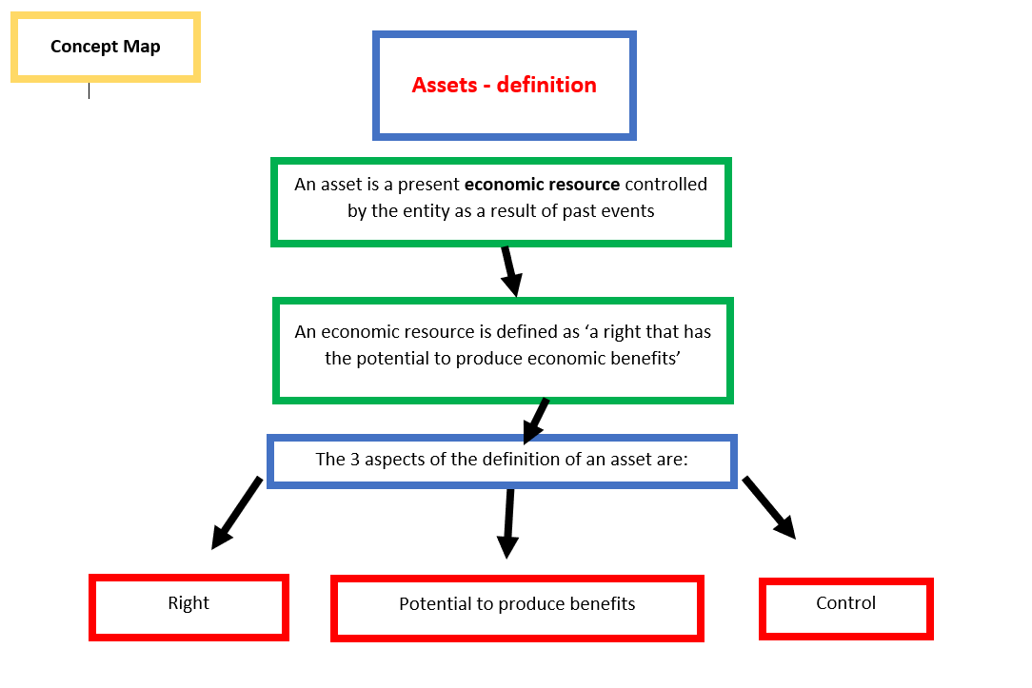

Slide 10
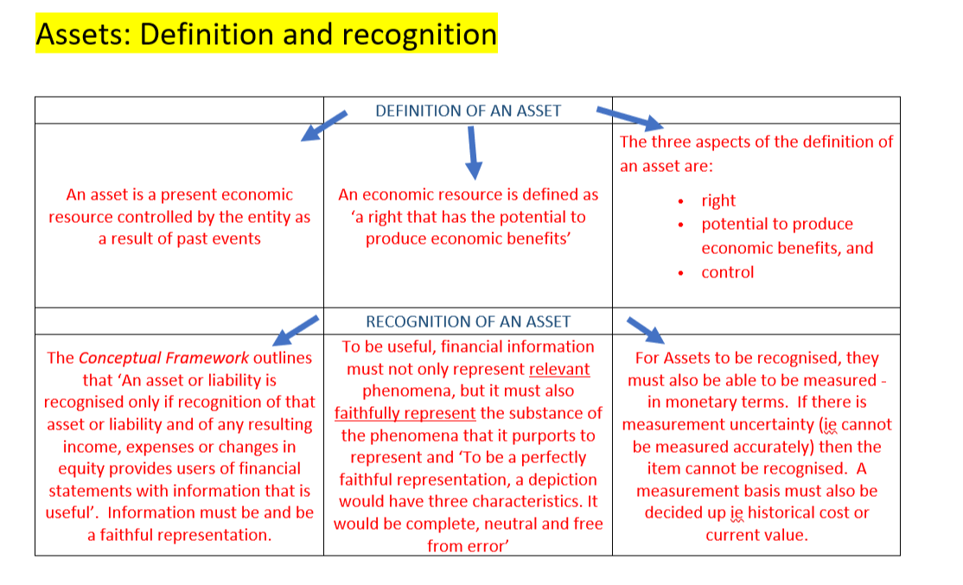

Slide 11
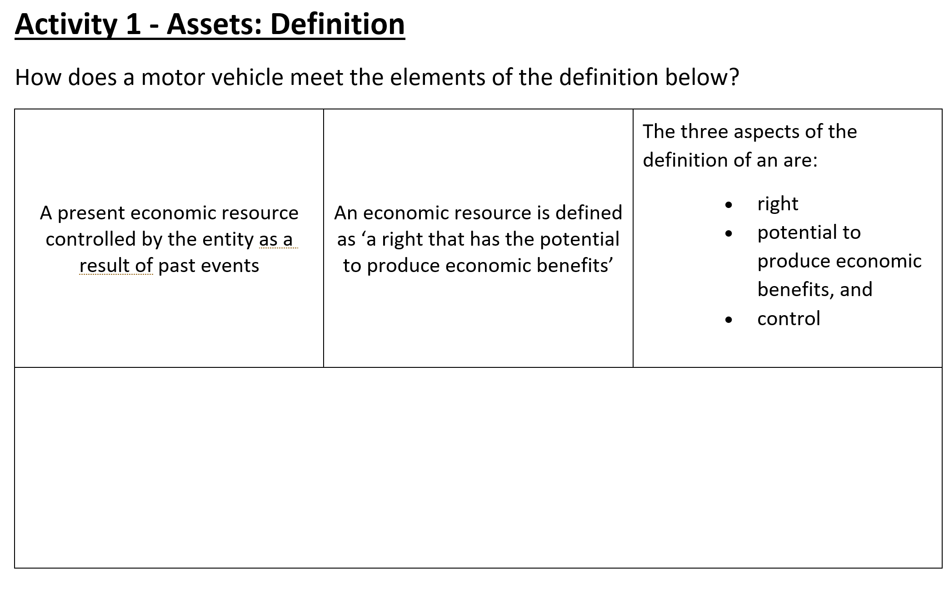
Activity 1: Asset definition

Slide 12
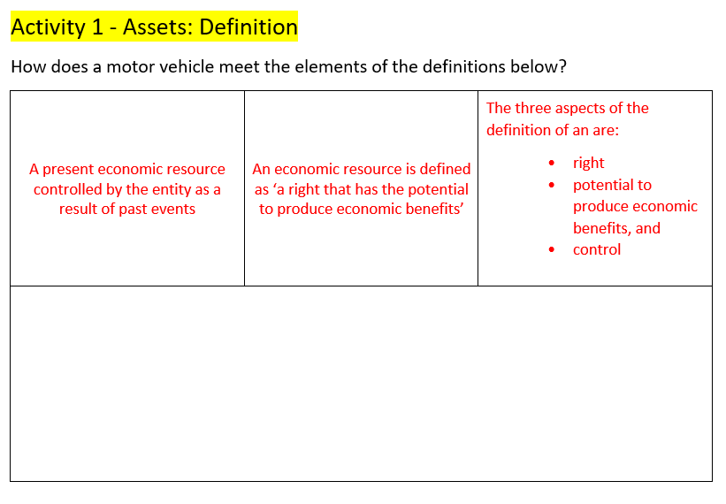
The motor vehicle is an economic resource (creates a right), it is controlled by the entity as they own it and it is the result of past events as they purchased it in the past
The motor vehicle is an economic resource as it creates “a right”. The right in this case is the right to control a physical item. It also has potential to produce economic benefit - income

Slide 13
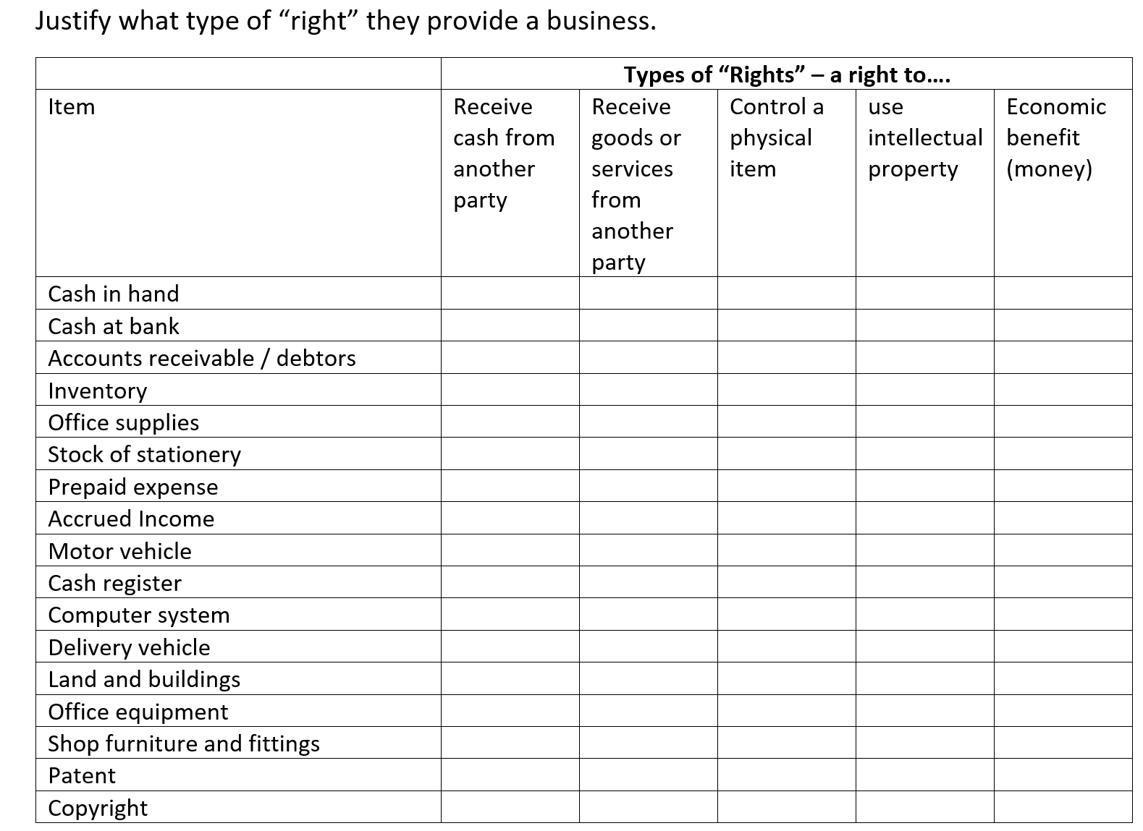
Activity 2: Asset definition – “Rights”

Slide 14
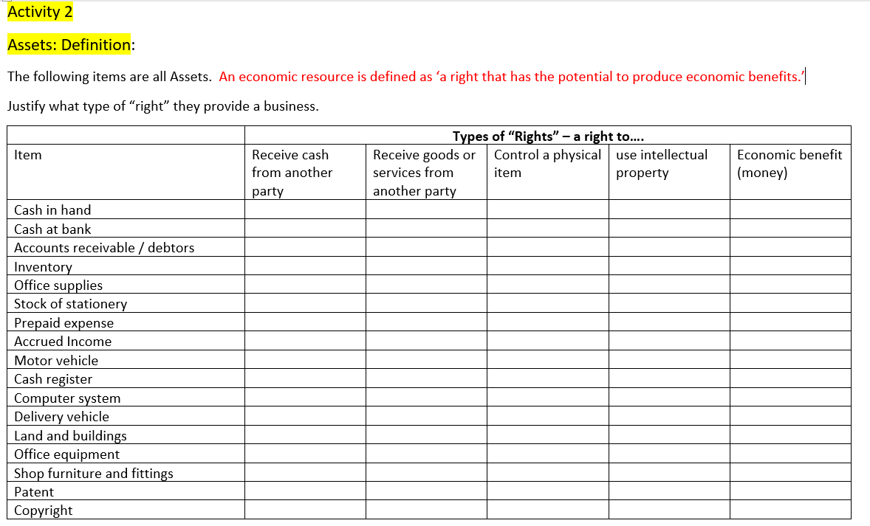
























Slide 15
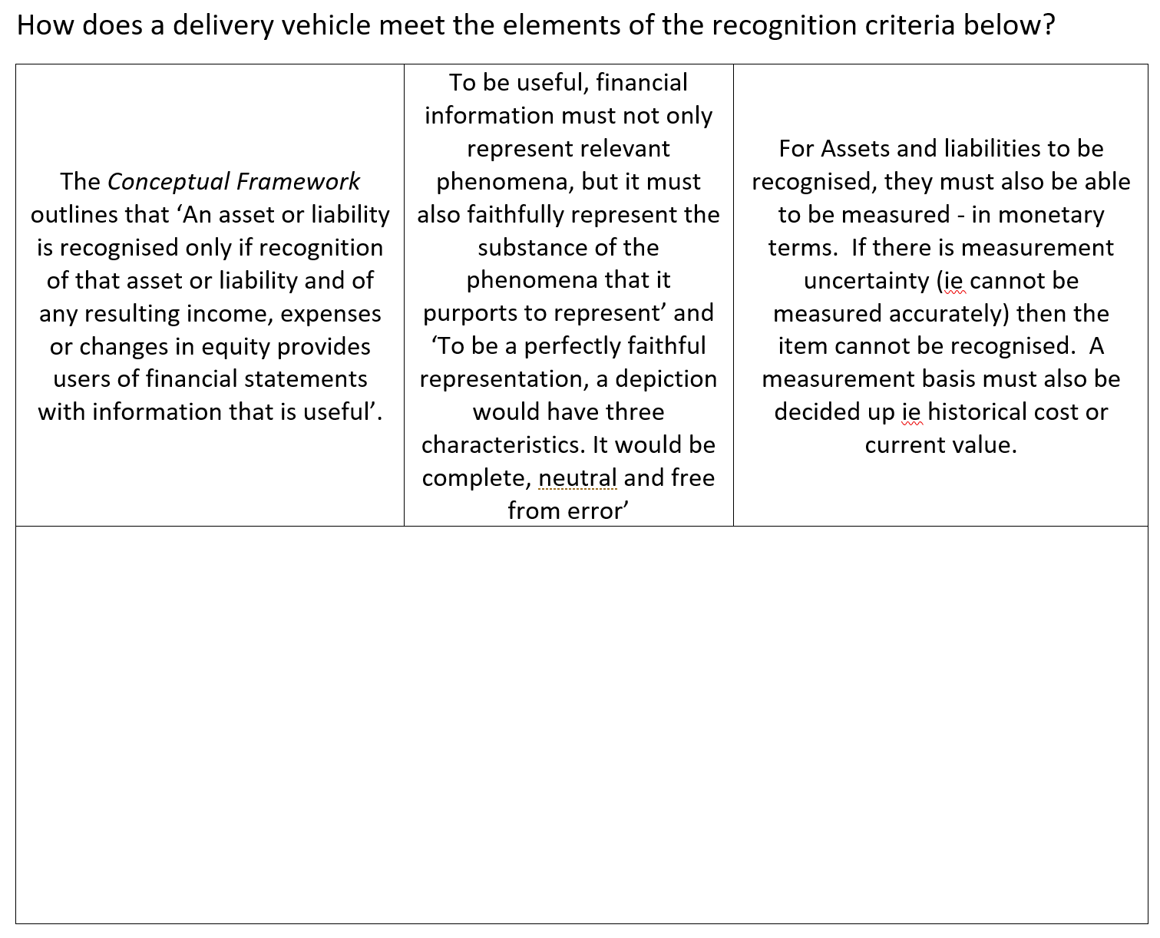
Activity 3: Asset recognition

Slide 16
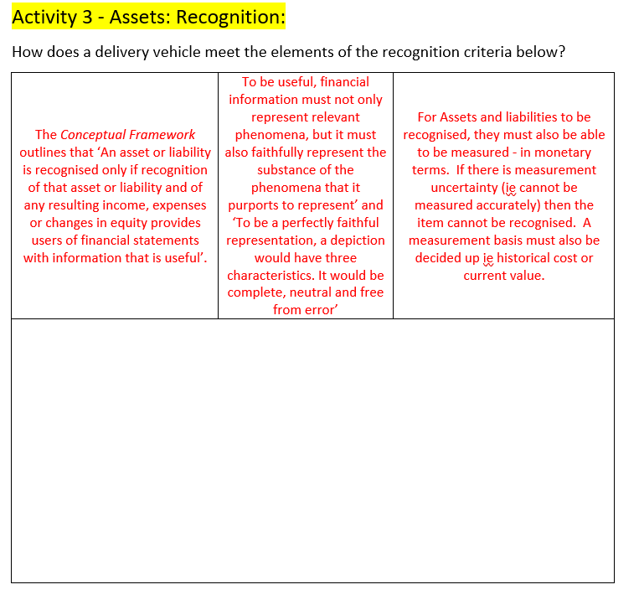
The delivery vehicle provides important information – the value of the delivery vehicle owned and its potential to provide economic benefit to the business
The $ value of the delivery vehicle will faithfully represent its value to the business (at the time of purchase)
Its stated value should be complete, neutral and free from error (in other words not over/under stated, not listed if not owned)
Must be measured in $ value – this will be the historical cost of the delivery van
Relevance: The asset exists and has a high probability of bringing in econ benefit (income – delivering goods in exchange for income)

Slide 17
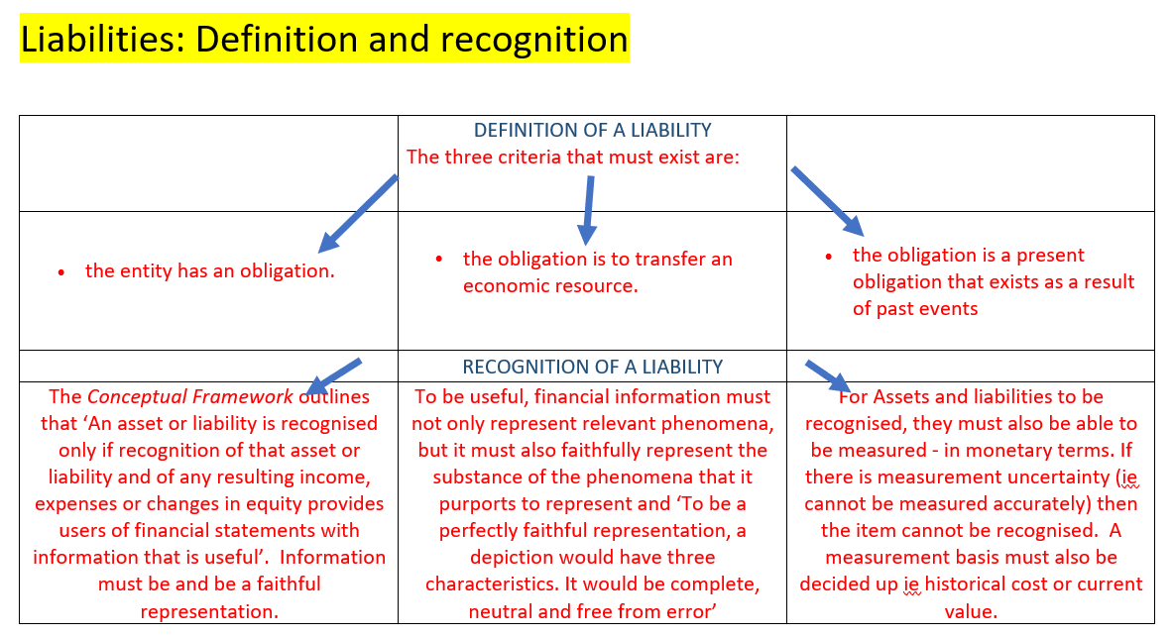

Slide 18
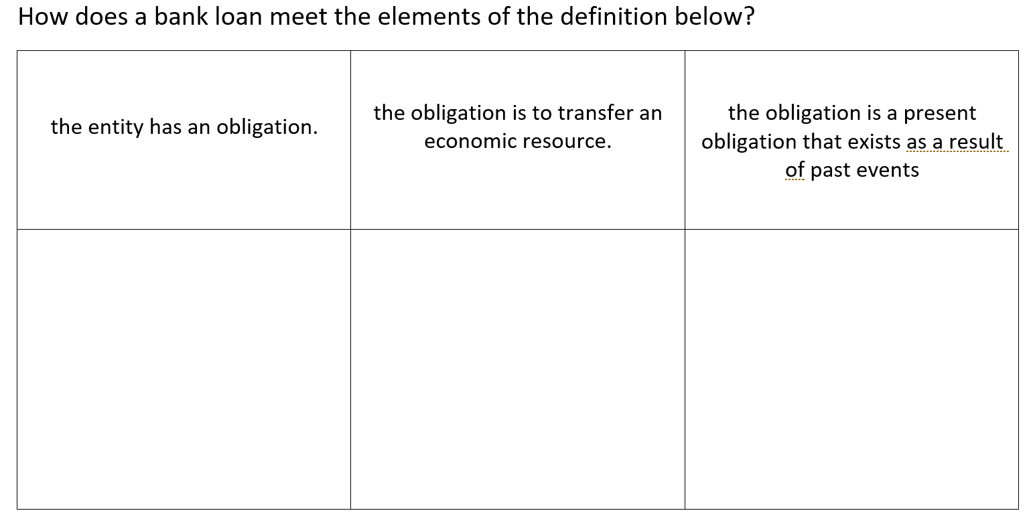
Activity 4: Liabilities definition

Slide 19
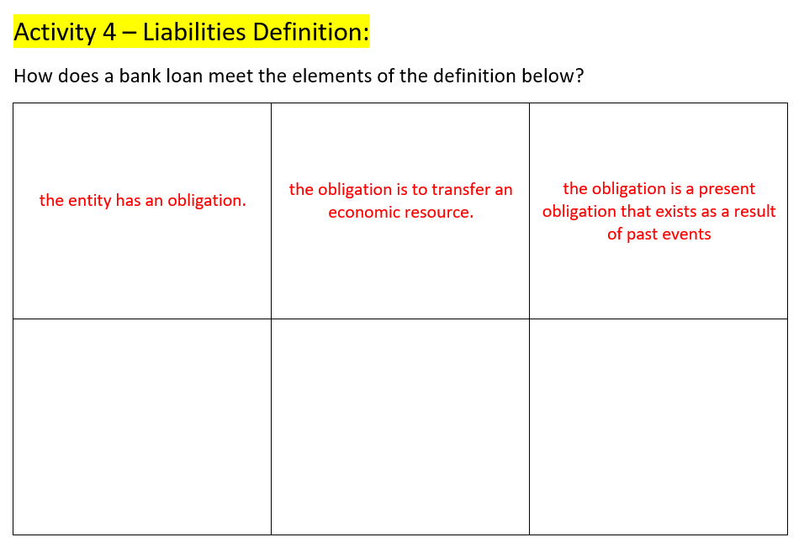

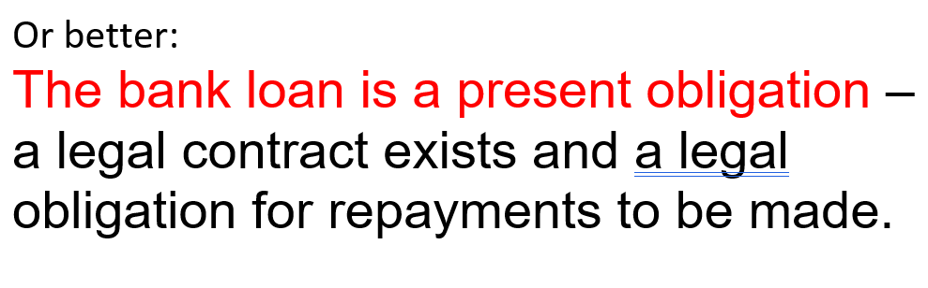

The obligation is to transfer an economic resource – money loaned (plus
interest) must be paid
back
The obligation is a result of past events – the loan was taken out in the past

Slide 20
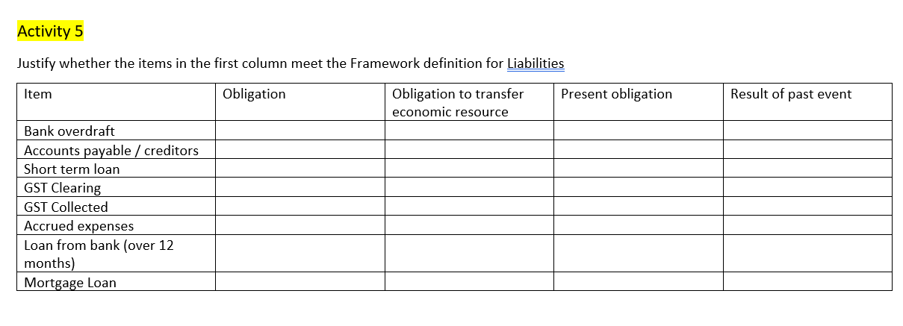
Activity 5 – liability definition….





Slide 21
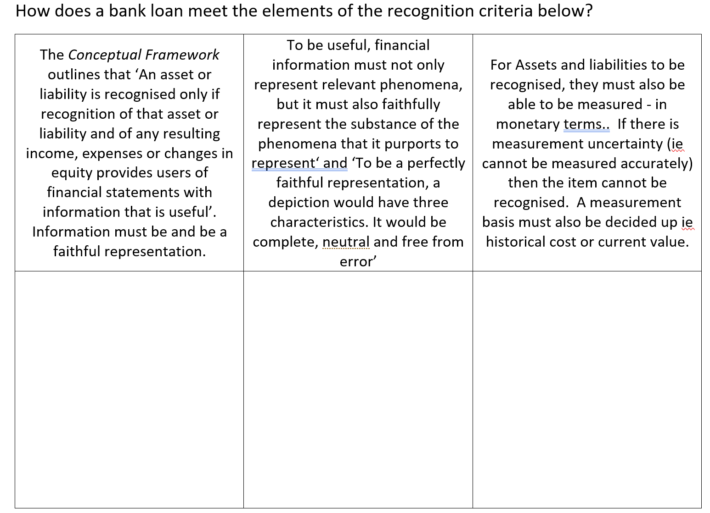
Activity 6: Liabilities recognition

Slide 22
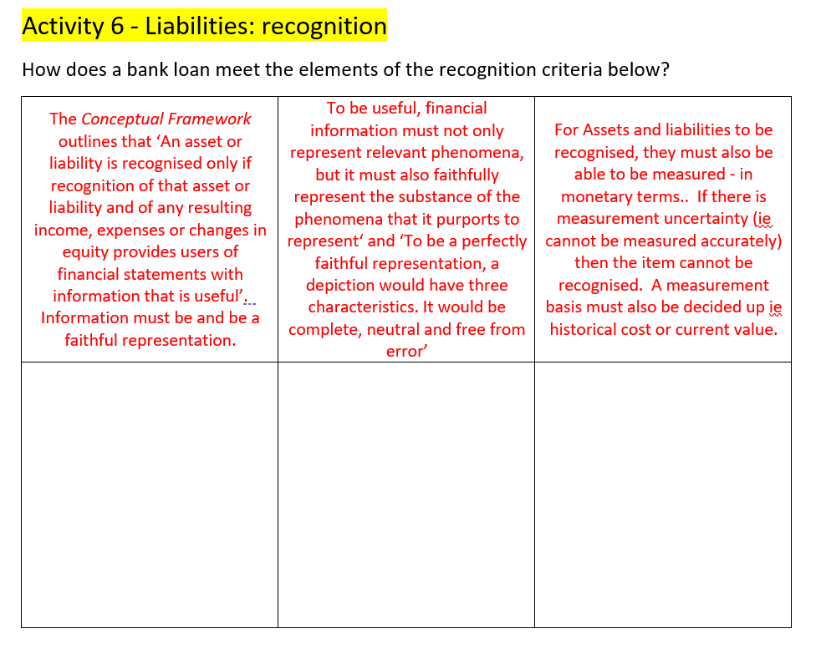
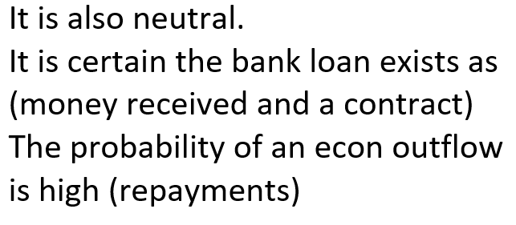
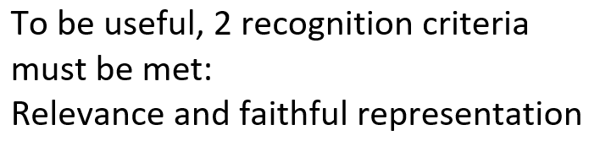
The bank loan is useful information – useful to know how much is owing to outsiders/know what debts are owed
The bank loan is faithfully represented – free from error – the amount stated as owing is correct
The bank loan can be measured in monetary terms – how much is owing in $ value

Slide 23
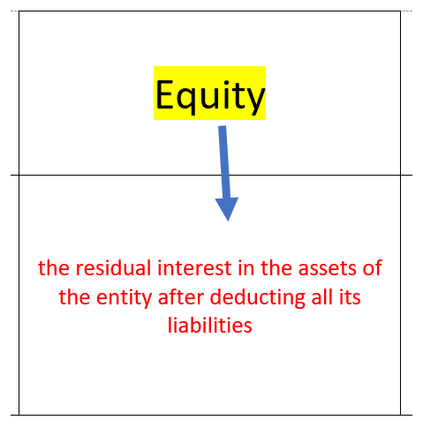
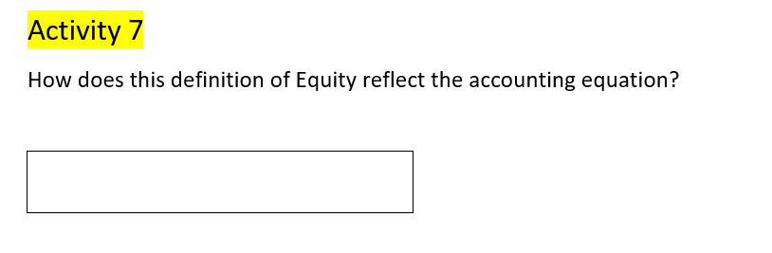
Assets – Liabilities = Equity

Slide 24
Income and Expenses
Students are required to understand the definitions of Income and Expenses as per the “Conceptual Framework”. It is also important to understand “Recognition” of Income and Expenses
The Conceptual Framework points out that recognition links the elements in the statement of financial position (assets, liabilities and equity) and the statement of financial performance (income and expenses). The link between the two statements arises because the recognition or change of one item requires the recognition or derecognition of one or more other items.
Derecognition is defined as “the removal of all or part of a recognized asset or liability from an entity’s statement of financial position”.

Slide 25
Recognition and derecognition
Income may be recognised as a result of the
initial recognition of an asset, or an increase in the carrying amount of an asset
derecognition of a liability or decrease in carrying amount of a liability
An expense may be recognised as a result of the:
initial recognition of a liability or increase in carrying amount of a liability
derecognition of an asset or an decrease in the carrying amount of an asset

Slide 26
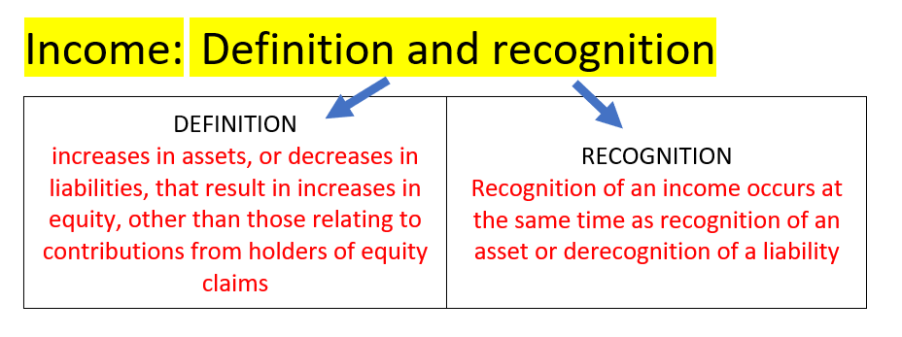
Income definition and recognition

Slide 27
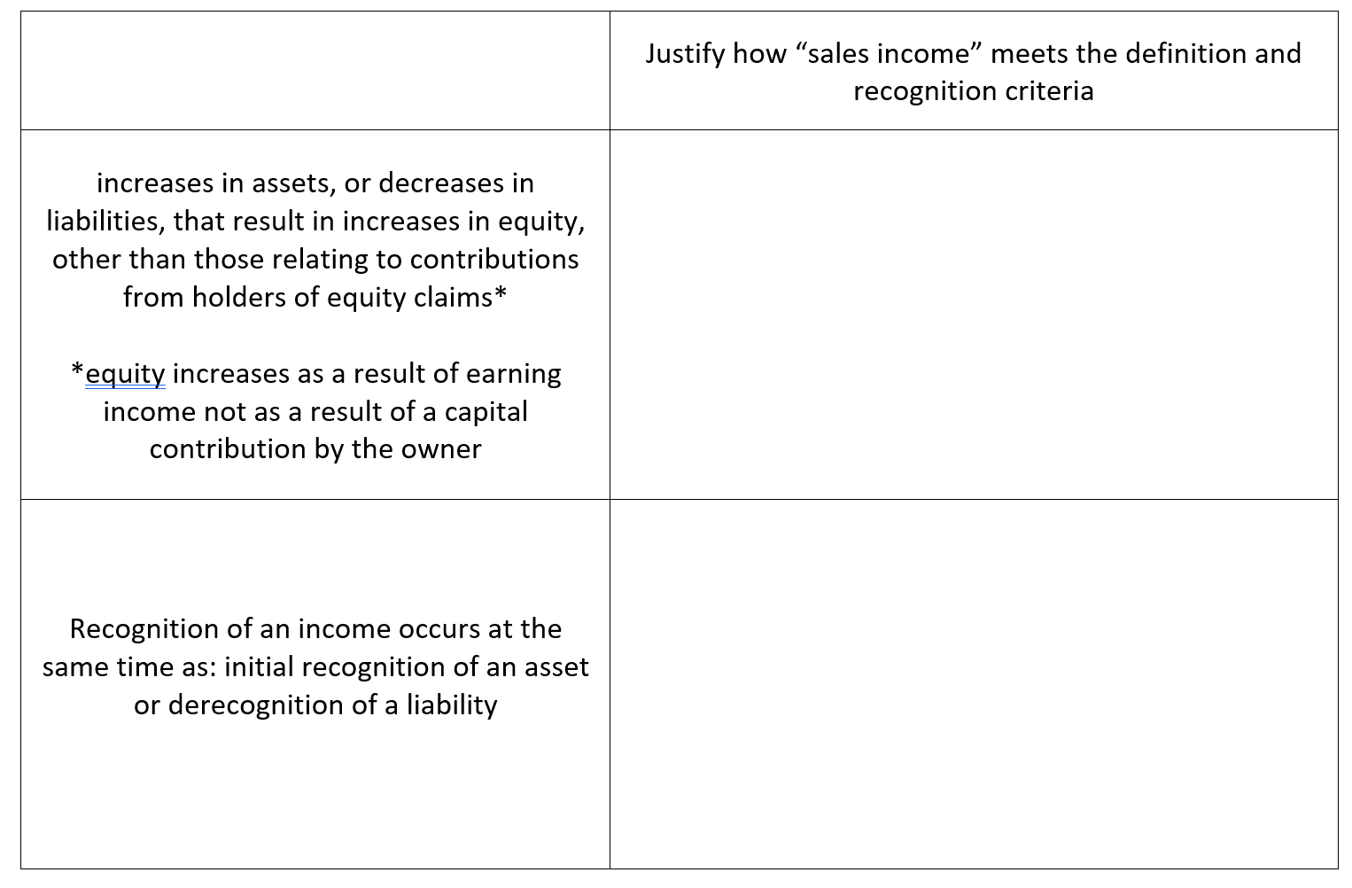
Activity 8&9: Income definition and recognition

Slide 28
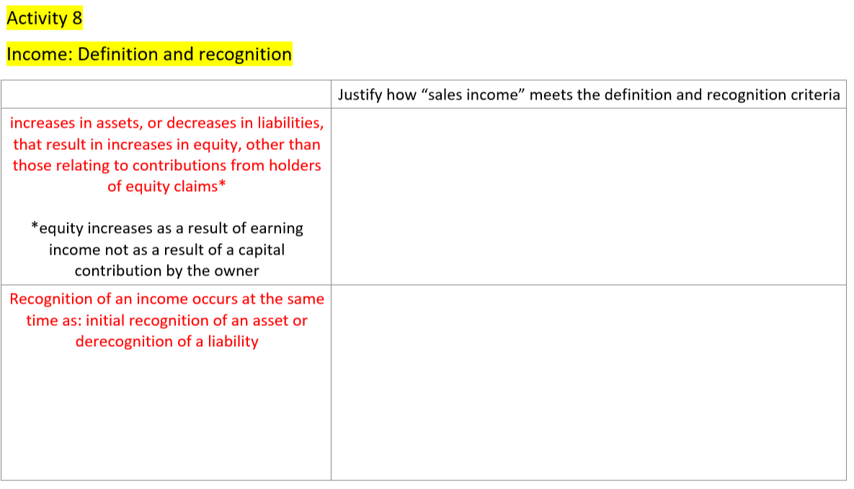
Sales income results in an increase in income but also an increase in assets (cash at bank/accounts receivable). Sales income increases equity (increase profit which increases equity) but it is not the result of a capital contribution by the owner
Sales income gets recognized at the same time as an increase to bank or accounts receivable (which are both assets)

Slide 29
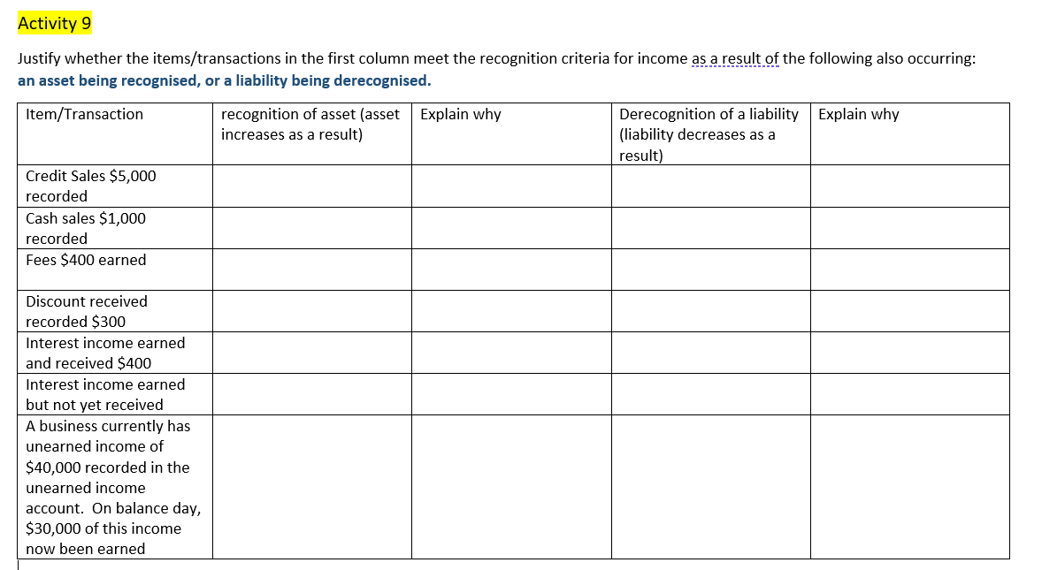


Increase to Acc Receivable

Increase to Bank
Increase to Bank

Decrease to AP
Increase to Bank
Increase to Accrued Interest Income
Decrease to Unearned income

Slide 30
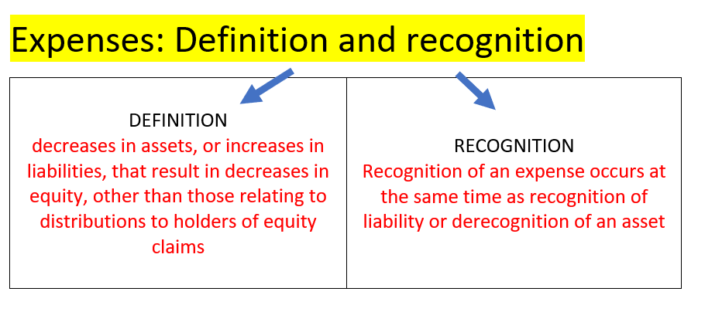
Expense definition and recognition

Slide 31
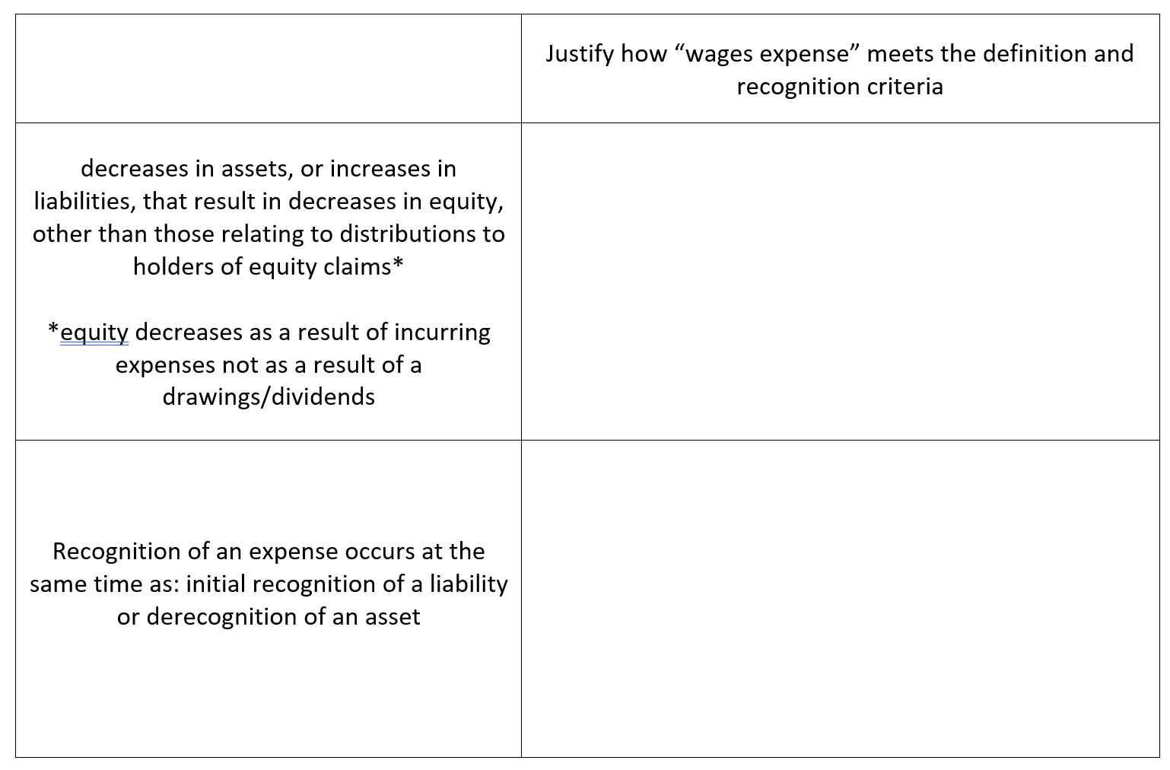
Activity 10: Expense definition and recognition

Slide 32
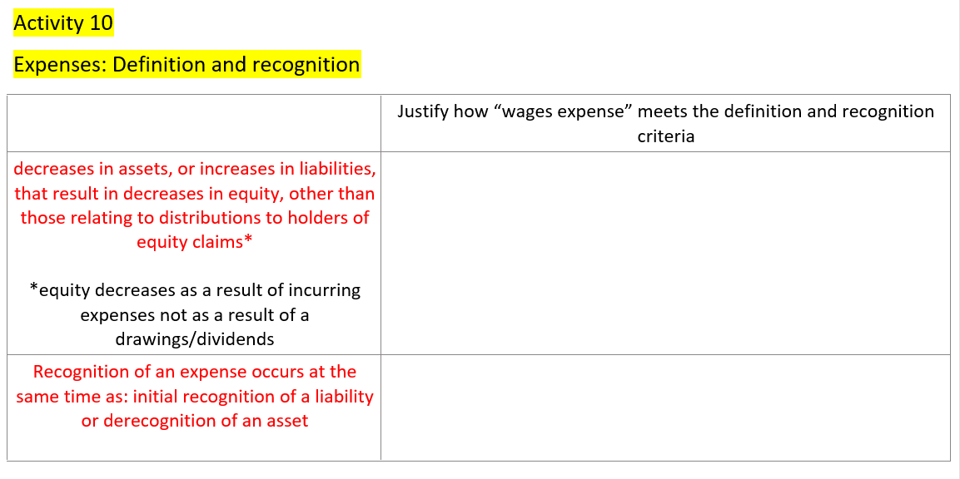
Wages expense results in decrease to equity as expenses decrease profit. This is a decrease to equity but is not the result of drawings by the owner.
The recognition of a wages expense will result in an increase to liability (accrued wages) if the expense has not yet been paid or decrease to asset (cash at bank)

Slide 33
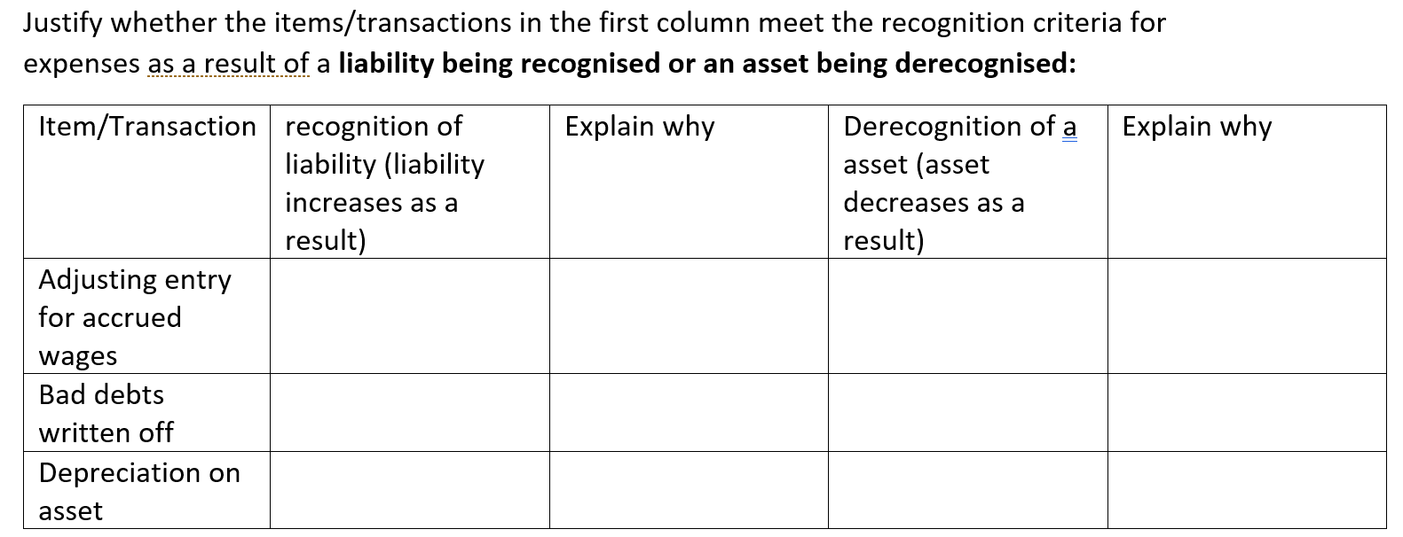
Activity 11: Recognition and derecognition

Slide 34
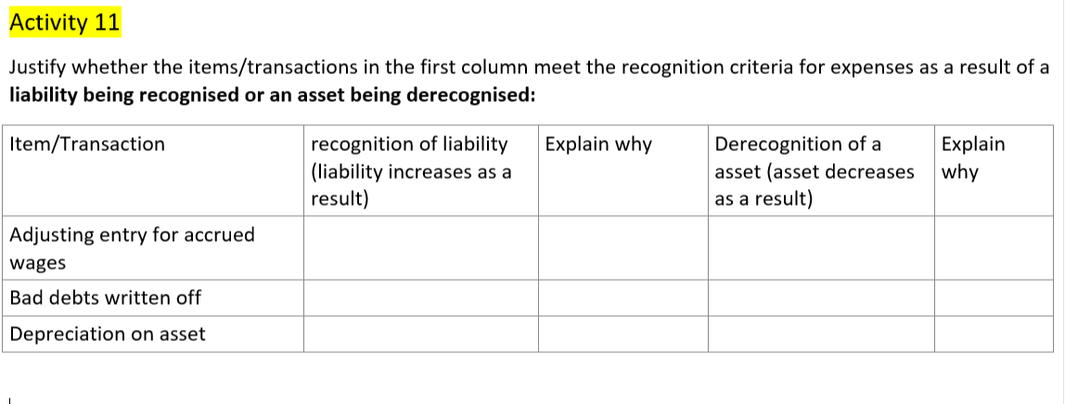
Result in an increase in an expense and….

Increase to Accrued wages

Decrease to Accounts Rec

Decrease to carrying amount of asset (as accumulated depreciation increases)

Slide 35
Activity 12: Recognition and derecognition
Income may be recognised as a result of the
derecognition of a liability
initial recognition of an asset
An expense may be recognised as a result of the:
initial recognition of a liability
derecognition of an asset
The following are transactions for a variety of businesses. Show the double entry effect of these transactions and identify what is being recognised and derecognised as a result of each transaction. This helps illustrate the recognition of income and expenses and the resulting recognition or derecognition of an asset or liability

Slide 36
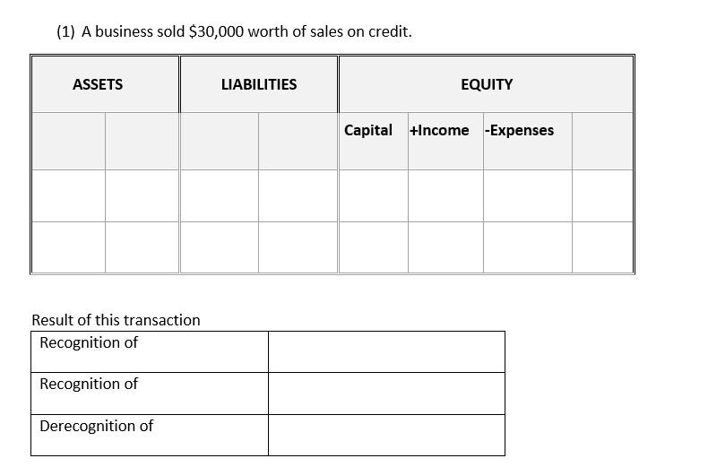
Acc Rec
$3,000
$3,000
Income - sales
Asset –
Accounts receivable

Slide 37
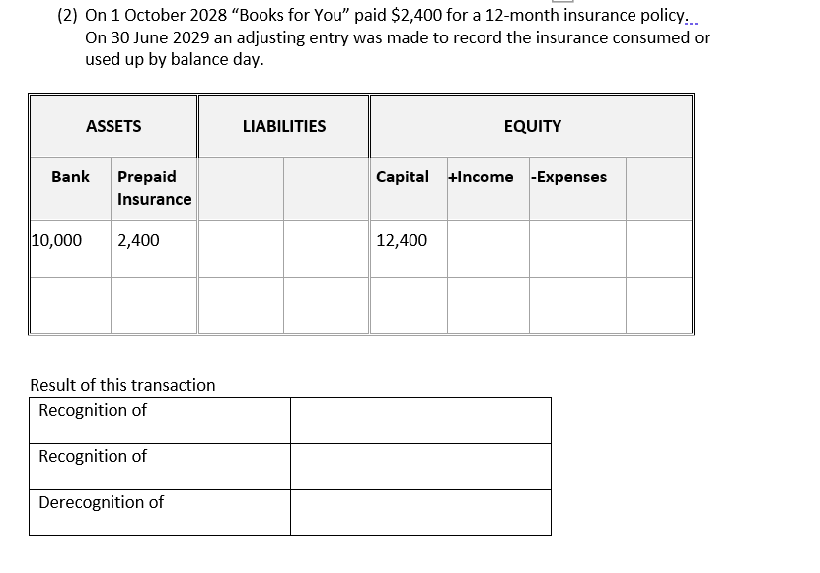
By balance day 2,400 x 9/12 = $1,800 consumed
By 1,800
By 1,800
**Expenses increase but the overall effect is that the total value of equity goes down
Expense - Insurance
Asset – prepaid
insurance

Slide 38
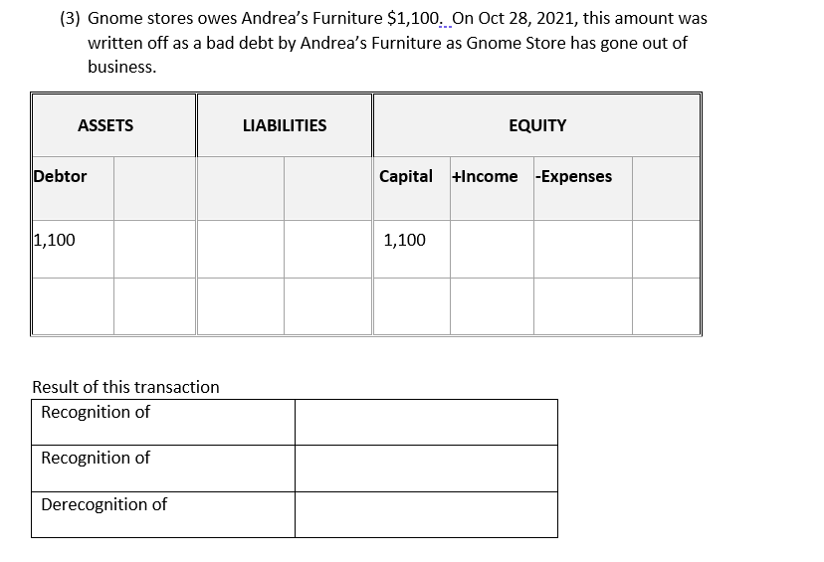
By 1,100
By 1,100
**Expenses increase but the overall effect is that the total value of equity goes down
Expense –Bad debts
Asset - Debtor

Slide 39
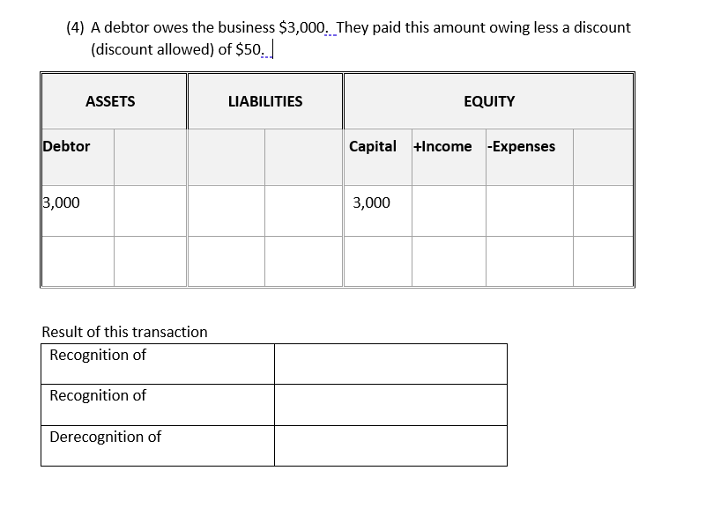
By 50
50
**Discount allowed expense reduces net sales therefore overall effect is to decrease total value of equity
Expense –Discount allowed
**This transaction would also result in bank increasing and debtor decreasing by $2,950 but this is not relevant to the recognition/derecognition being illustrated
Assets - debtor

Slide 40
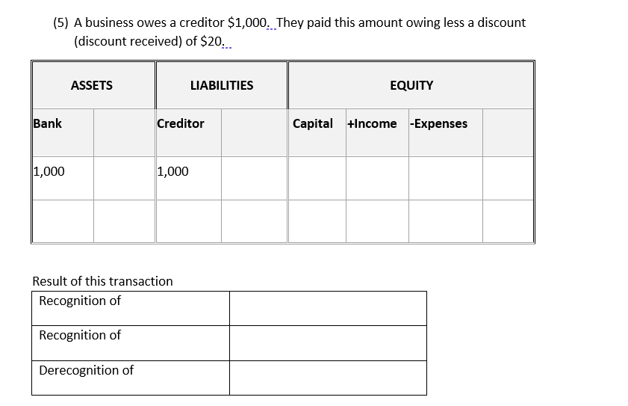
By 20
By 20
**Discount received is an income which reduces cost of sales therefore overall effect is to increase total value of equity
Income –Discount received
**This transaction would also result in bank decreasing and creditor decreasing by $980 but this is not relevant to the recognition/derecognition being illustrated
Liability - Creditor

Slide 41
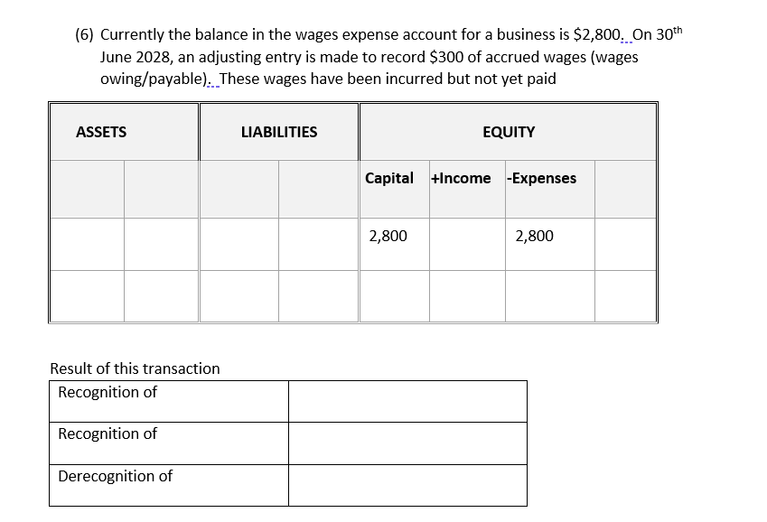
Accrued wages
By 300
By 300
Expense – increase to wages
Liability – accrued wages

Slide 42
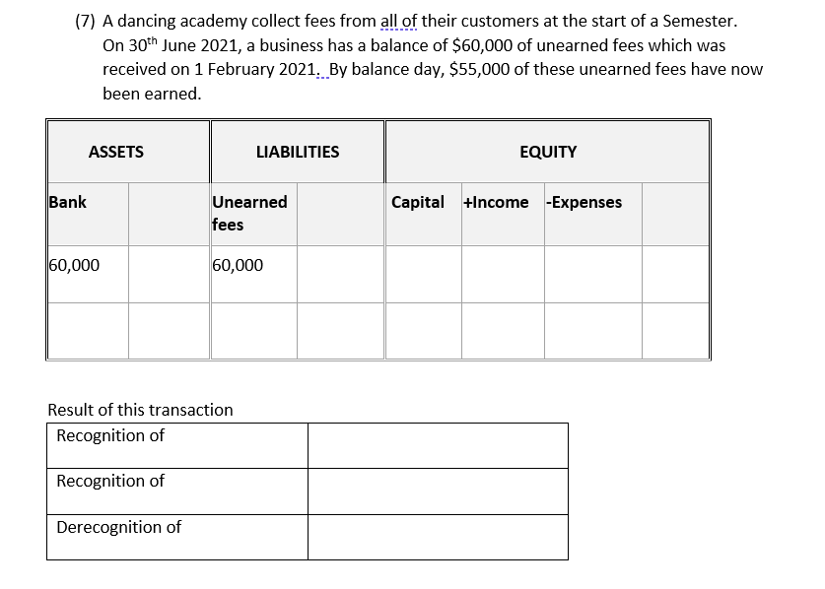
By 55,000
By 55,000
Income - Fees
Liability – unearned fees

Slide 43
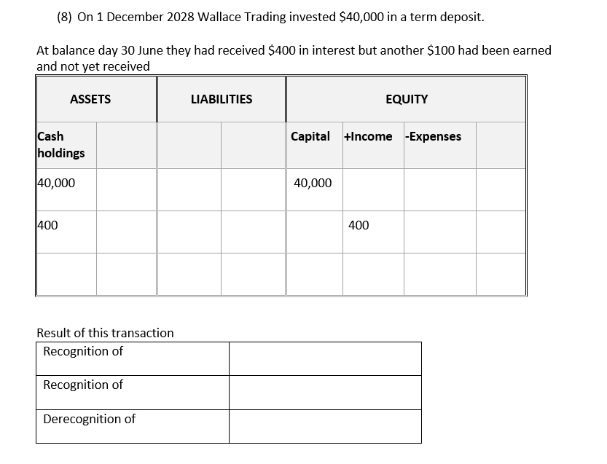
By 100
By 100
Income - interest
Asset – Accrued interest

Slide 44
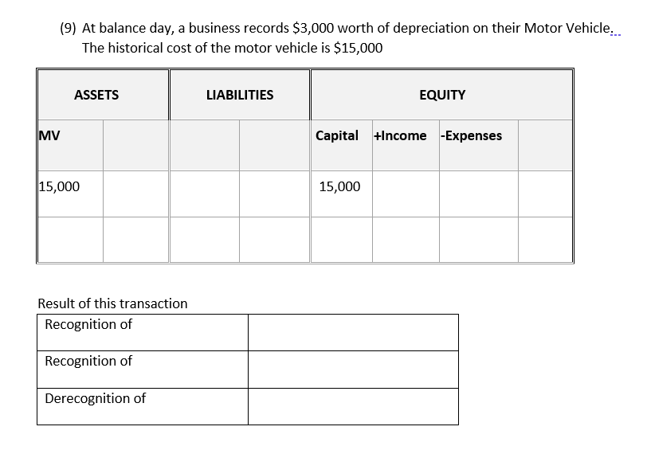
Acc Dep
By 3,000
By 3,000
**Accumulated depreciation increases but carrying amount of asset now $12,000
**Expenses increase but the overall effect is that the total value of equity goes down
Expense - depreciation
Asset (carrying amount of mv goes down)

